Slide 1

AVISHKAR
KRIPA 24P61A67A4 CSD - B
M. RUTVIKA 24P61A67D7 CSD - C

Slide 2
Develop a Low-Bandwidth communication framework that enables rural patients to access medical consultations despite limited internet connectivity.

Slide 3

Problem Explanation
In rural regions limited internet connectivity restricts access to online medical consultations.
Most telemedicine platforms require stable high-speed internet for effective communication.
Patients experience delays in diagnosis and treatment due to connectivity issues.
To mitigate this challenge we use low-bandwidth communication, data compression and offline synchronization techniques to enable reliable healthcare delivery under constrained network conditions.

Slide 4

Solution
The framework enables patients to connect with doctors using optimized low-data communication channels.
It compresses medical data such as images, voice notes and text before transmission.
Patient data is stored locally and synchronized automatically when internet becomes available.
A symptom reporting module supports reliable and accessible healthcare delivery for rural populations.

Slide 5
Domain Chosen
Low-bandwidth networking enables communication under limited internet conditions.
Data compression reduces the size of medical data for efficient transmission.
Cloud synchronization ensures that stored data is updated when connectivity is restored.
Healthcare informatics enhances digital patient record management and improves consultation efficiency.

Slide 6
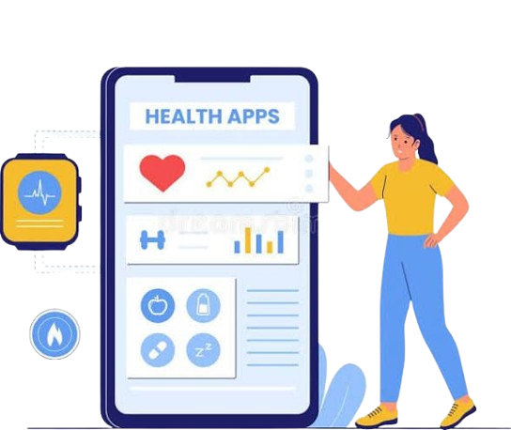
Feasibility of Solution
Lightweight communication protocols enhance system performance in low connectivity environments.
Offline synchronization supports continuous data collection during network interruptions.
The framework operates on smartphones and low-cost digital devices.
Current telemedicine advancements make the solution scalable and practical for implementation.

Slide 7
Comparing with Existing Solutions
EXISTING SOLUTIONS | PROPOSED SOLUTION
Requires stable high-speed internet for video consultations. Cannot function effectively in low-bandwidth regions. Provides limited offline support for patient data storage. Consultations are interrupted during connectivity failures. | Operates effectively in low-bandwidth environments. Utilizes compressed text, voice and image transmission. Supports offline caching and automatic synchronization. Ensures uninterrupted healthcare access in rural regions.

Slide 8

Applications
Enables rural healthcare centers to provide remote consultations.
Assists community health workers in offline data collection within village environments.
Supports emergency symptom reporting in weak network zones.
Expands digital healthcare access through government and NGO initiatives.

Slide 9
QUERIES?

Slide 10
THANK YOU

